Slide 1
Boolean Algebra & Logic Gates
Chapter 2C
Imran Siddiqi
imran.siddiqi@mcs.edu.pk
Computer Science Department
College of Telecommunication Engineering
National University of Sciences and Technology

Slide 2
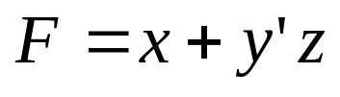
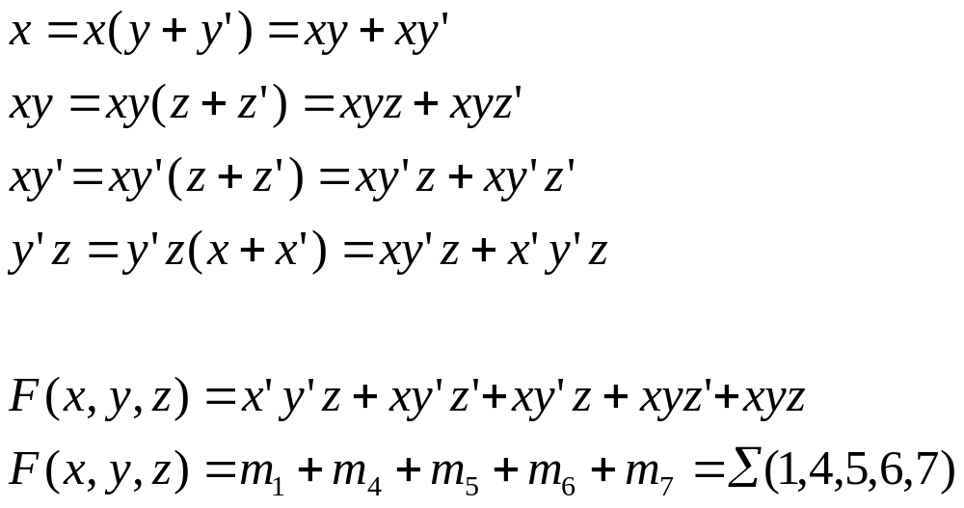
Example: Sum of Minterms
Express the Boolean function
in a sum of
minterms.
AIM: Convert it to 3 variable AND Terms and take their SUM
Adding all terms and excluding recurring terms:

Slide 3
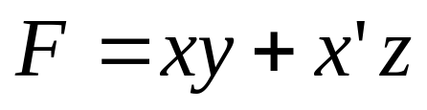
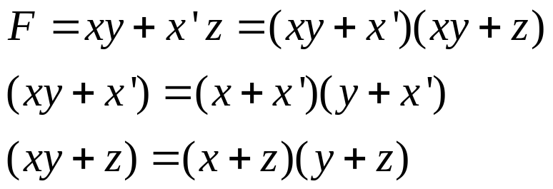
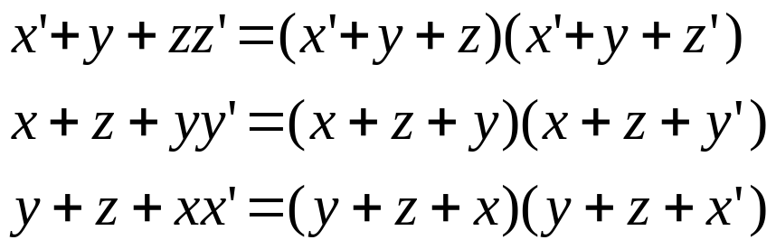
Example: Product of Maxterms
Express the Boolean function
in a Product of
Maxterms.
AIM: Convert it to 3 variable OR Terms and take their Product
(Distributive law)
(Remove any recurring terms)
M₀M₂M₄M₅ = F(x,y,z)=Π(0,2,4,5)

Slide 4
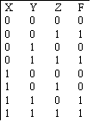
Using Truth Table
Find Sum of Minterms and Product of MaxTerms of F= xy+x’z
Find Sum of Minterms & Product of Maxterms from truth table
  F(x,y,z)= ∑(1,3,6,7)
  F(x,y,z)= П (0,2,4,5)

Slide 5
Conversion b/w Canonical Forms
Complement of a function expressed as sum of minterms equals sum of minterms missing from the original function
Complement is
Complement of F’ is F
F(A,B,C) = ∑(1,4,5,6,7)= m₁+m₄+m₅+ m₆+m₇
F’(A,B,C)= ∑(0,2,3) = m₀+m₂+m₃
F = (m₀+m₂+m₃)’ = = m’₀. m’₂ . m’₃ = = M₀.M₂.M₃= П(0,2,3)

Slide 6
Standard Forms
Sum of Products (SOP)
  F= y’ + xy+ x’yz’
  Sum denotes OR of these terms
Product of Sums (POS)
  F= x(y’+z)(x’+y+z’)
  Product denotes AND of these terms

Slide 7
Sum of Products
F= y’ + xy+ x’yz’
x’
y
z’
F
y’
x
y

Slide 8
Product of Sums
  F= x(y’+z)(x’+y+z’)
x’
y
z’
F
x
y’
z

Slide 9
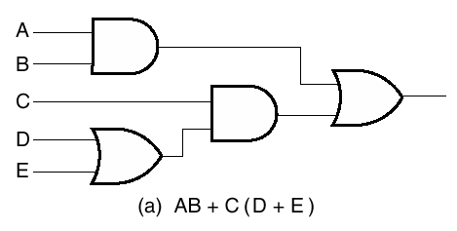
Non Standard Boolean Function
Boolean Expression in non standard form F=AB+C(D+E)
Neither SOP or POS
Implemented in 3 levels

Slide 10
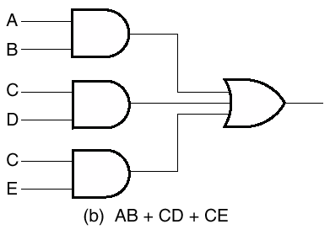
Non Standard Boolean Function
F=AB+C(D+E)
Convert to Standard Form by distributive law
F=AB+C(D+E) = AB+CD+CE
Draw 2 Level Standard Sum of Product Circuit

Slide 11
References
Chapter 2 – Digital Design Morris Mano
Digital Logic Circuits – V.D. Agrawal, Auburn University, Auburn
Logic System Design – Seattle Pacific University
Material in these slides has been taken from, the following resources

